Slide 1





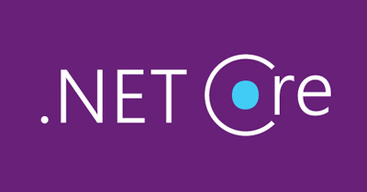


API Gateway in a Nutshell
Allan A. Chua

Slide 2
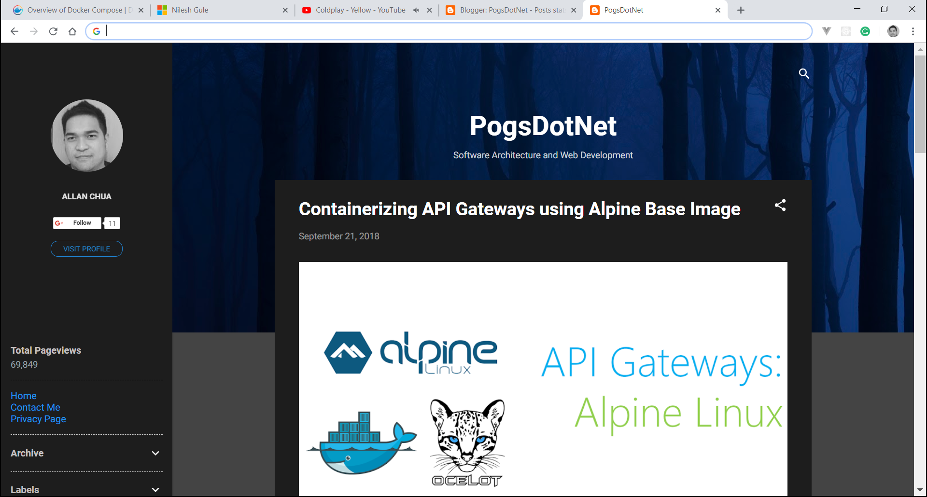
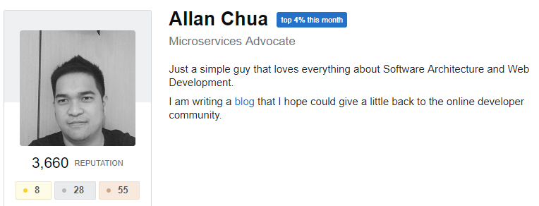
About Me
Loves Software Architecture
Camera Man for Engineers.SG
Polyglot Developer (C#, Java, NodeJS)
Googles better than an average bear
http://www.pogsdotnet.com/

Slide 3
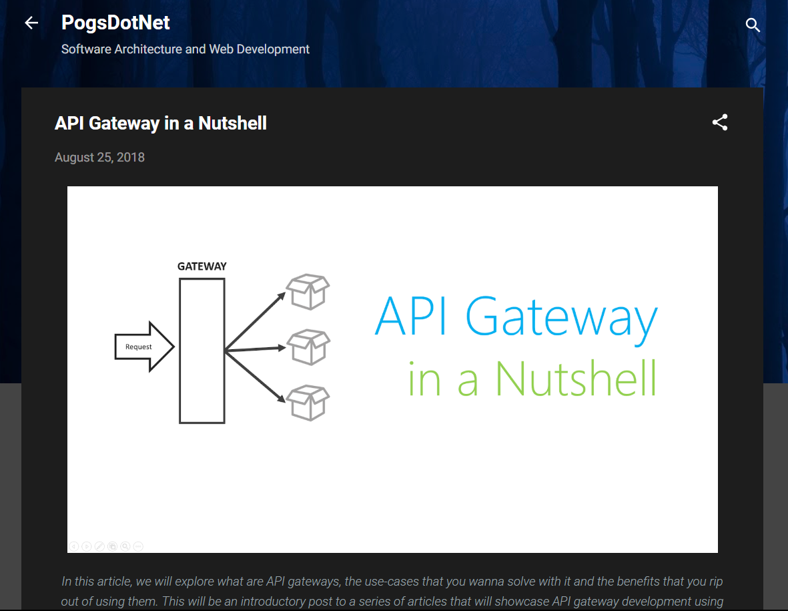
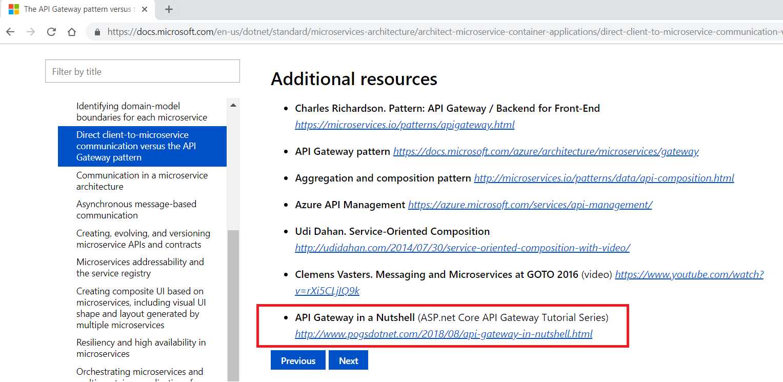
Author of API Gateway in a Nutshell
https://bit.ly/2O4IbAU
https://bit.ly/2Dpq44B

Slide 4
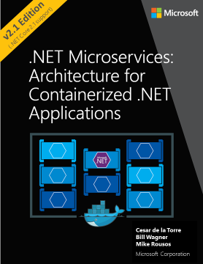
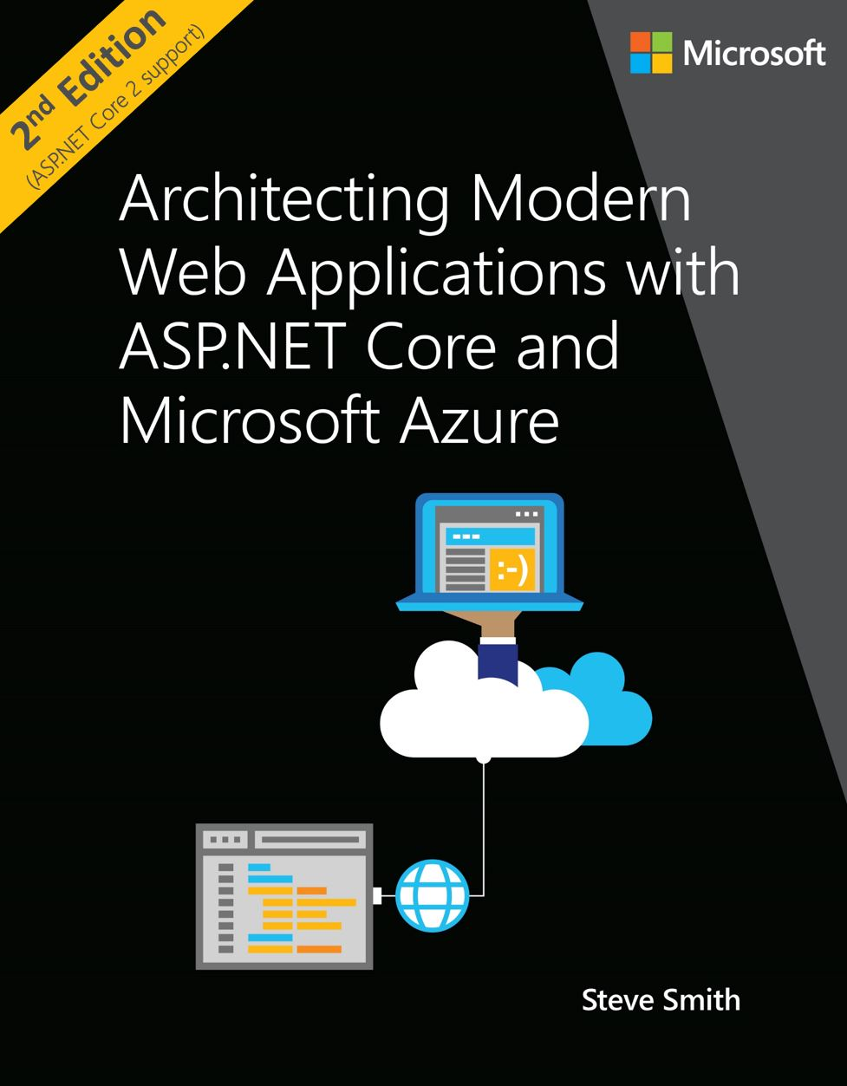
Free E-Books
https://www.microsoft.com/net/learn/dotnet/architecture-guides

Slide 5
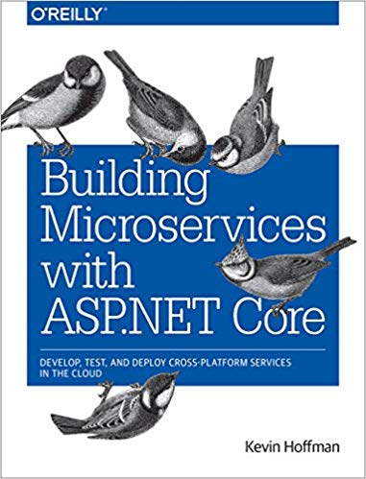



Resources

Slide 6
Agenda
Abstract
What are API Gateways?
Benefits
Implementations, Tools and Frameworks
Demo
Docker Helps in Gateway Development
Desired State Management with Kubernetes
Things to Consider
Notes:
Thin Gateways using Istio Mesh

Slide 7

Notes:
How many of you guys know about the international space station?
When I was a kid, I’ve always admired those engineers who built the international space station, because its huge and it just orbits around the earth.
If you think about it, “Man, how did they even built that thing because its huge and if they build this thing on earth, you got all sorts of trouble lifting it up in the sky”

Slide 8
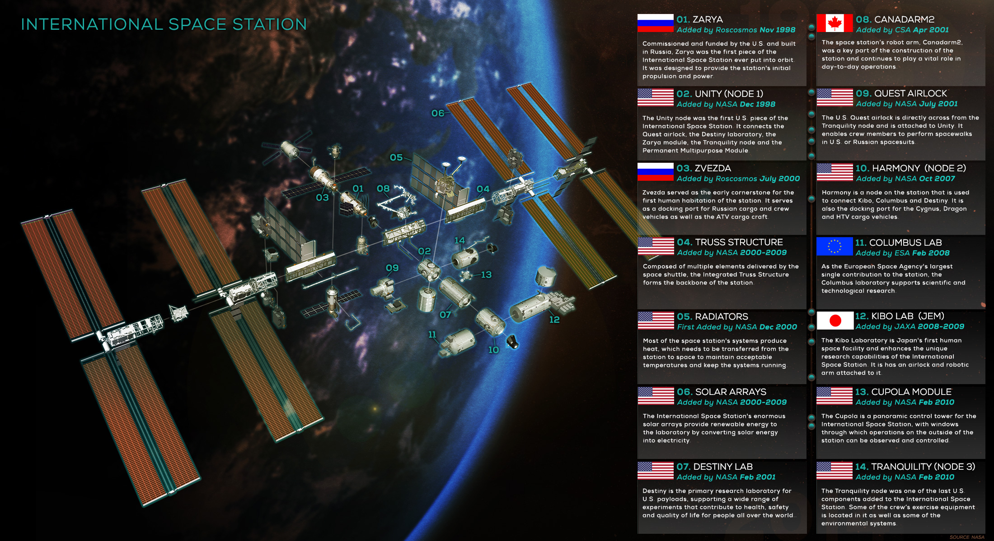
Notes:
Apparently, what they actually did is that they built this thing out of smaller modules and flew them piece by piece up in the sky which is really cool. But what makes it really cool is that the engineers that built the ISS did not came from a single country.

Slide 9
Lesson of the Story

Slide 10
HUGE
complex
problems
DON’T NEED
HUGE
complicated
solutions

Slide 11
all you need is
a combination of
small & simple
solutions

Slide 12

microservices

Slide 13


Most engineering teams plan to build this
Web API
Ledger
Web API
Catalog
Web API
Authentication

Slide 14
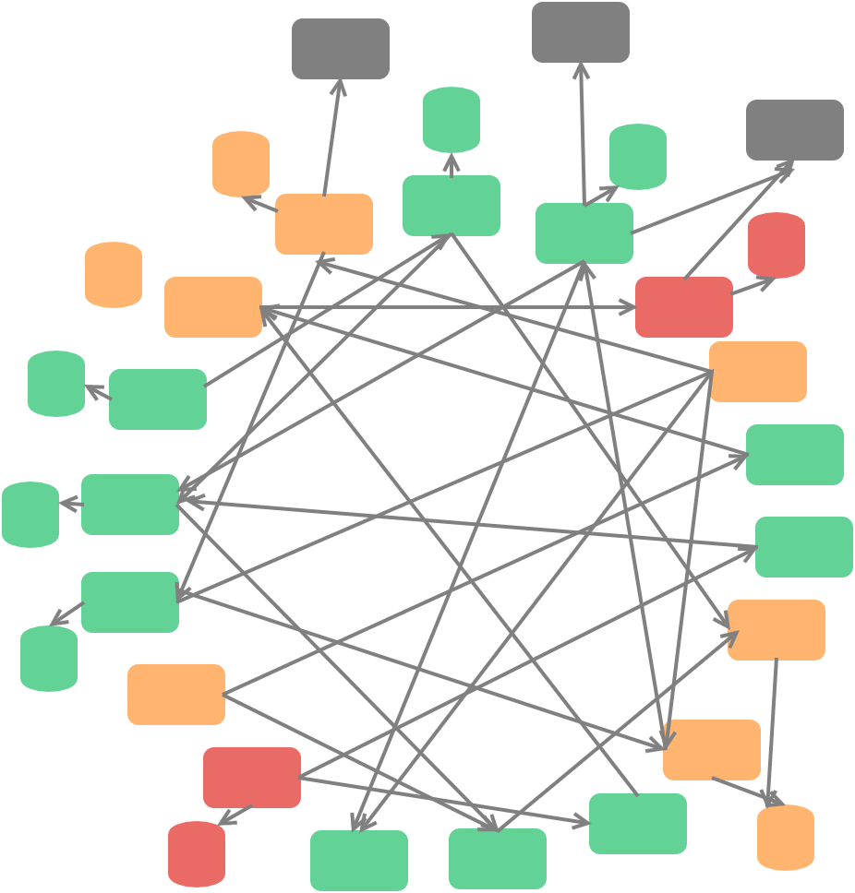
But they end up with this
DEATH STAR PITFALL
Intense Coupling
Hard to make changes
Maintenance Chaos

Slide 15
Bounded Contexts
LEDGER
CATALOG
AUTH
https://martinfowler.com/bliki/BoundedContext.html

Slide 16
BOUNDED CONTEXT ISSUES
????
????
????
????
Multiple Point of Contacts

Slide 17

BOUNDED CONTEXT ISSUES
Multiple Point of Attacks

Slide 18

BOUNDED CONTEXT ISSUES
JWT Token A
JWT Token B
JWT Token C
Cookies Against
N Servers?
Authentication Issues

Slide 19
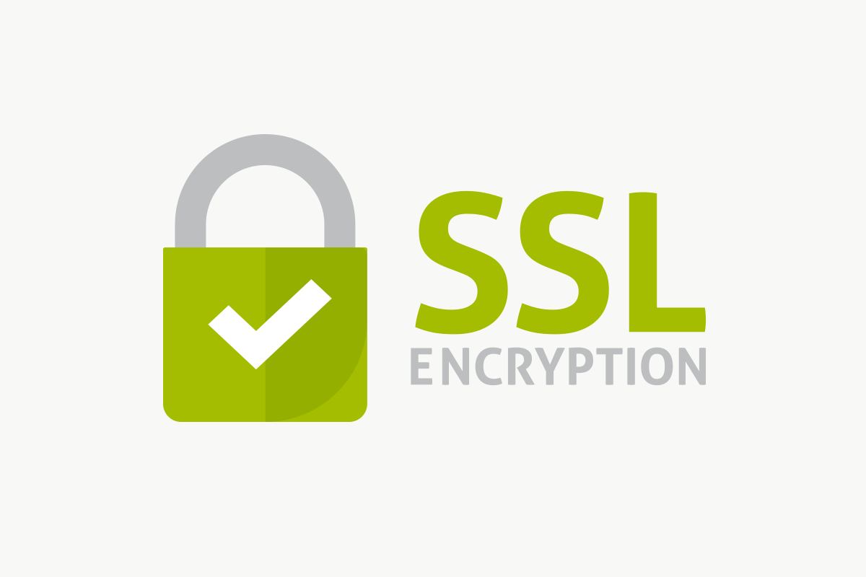
BOUNDED CONTEXT ISSUES
Cross Origin Sharing
is troublesome
Buy multiple SSL
Certificates + Domains?
CORS, Domain Name and SSL

Slide 20
BOUNDED CONTEXT ISSUES
LEDGER
CATALOG
CUSTOMERS
Each team working on
a bounded context
will have a hard time
releasing their changes
Tightly Coupled Client and APIs

Slide 21
API Gateway
Web API
Ledger
Web API
Catalog
API Gateway
Web API
Authentication
Notes:
An API gateway is an architectural pattern that enables a microservice ecosystem to look like a single application from an outer point of view.

Slide 22
API Gateway vs Reverse Proxy
API Gateway
Rate Limiting
Logging
Response Aggregation
Caching
Authentication
Reverse Proxy
Notes:
Most of the time API Gateways are compared to Reverse Proxies.

Slide 23
BENEFITS OF USING AN API GATEWAY
Sub-Domain Encapsulation
Single Point of Contact
Faster Cross Continental Communication
Centralized Authentication
Single CORS, Domain Name and SSL
Added Layer of Security
Centralized Cross Cutting Concerns

Slide 24
CROSS CUTTING CONCERNS
Authentication
Logging
Monitoring
Circuit Breaking
Retries with Jitter
SSL Termination
Whitelisting
Response Aggregation
Rate Limiting

Slide 25



Implementation Choices
Cloud
Management
Platform
Generic
Software
CODE
Code / Config
Hybrid

Slide 26


API Management Platforms Provided by Cloud Platforms
Cloud
Provider
Azure API Management
AWS API Gateway

Slide 27
Aggregation
Reverse Proxying
Versioning
Mock Responses
Test Console
Public vs Private APIs
Rate Limiting
Application Insights Integration
Live Metrics System
Azure API
Management

Slide 28
PROS
CONS
Can Get Up Quickly
Cheapest Solution
Wide Community Support
Good for Startups.
Coupled to Provider
Hard to migrate
Limited Features
Compliance Issues
Cloud
Provider

Slide 29



Generic
Software

Slide 30
PROS
CONS
Can Get Up Quickly
Semi-Cheap Solution
Smaller Community Support
Plugins
Hard to migrate
Limited Features
Risk of dying plugins
Compliance Issues
Generic
Software

Slide 31


PROS
CONS
Highest Form of Control
Unlimited options
Don’t need specialization
Highly decoupled solutions
Build and ship what you only need
No Compliance Issues
Takes time build
Expensive to build
Like investment
CODED

Slide 32


PROS
CONS
More control
Unlimited options
Flexible Approach
Average time to build
Confusion on which to pick between the two.
Compliance Issues with Libraries
+
Coded
Hybrid

Slide 33
Strangler Migration
Web API
Monolith
API Gateway

Slide 34
Strangler Migrations
Web API
Monolith
API Gateway
Web API
Authentication

Slide 35
Strangler Migrations
Web API
Monolith
Web API
Catalog
API Gateway
Web API
Authentication

Slide 36
Demo
Web API
Ledger
Web API
Catalog
API Gateway
Web API
Authentication

Slide 37

Dockerized Gateways
Web API
Ledger
Web API
Catalog
API Gateway
Web API
Authentication
https://bit.ly/2Ao0XeO

Slide 38
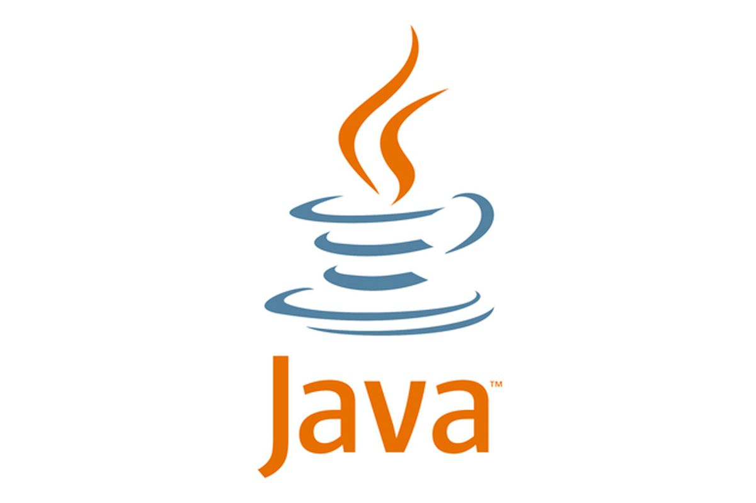
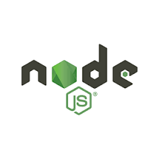

Polyglot Teams and Gateways
Web API
Ledger
Web API
Catalog
API Gateway
Web API
Authentication

Slide 39
No Lockdown to old versions
Web API
Ledger
Web API
Catalog
API Gateway
Web API
Authentication
Node 6 - Promises
Node 8 – Async / Await
Node 10 – HTTP/2

Slide 40

Cluster Desired State Management
LEDGER
AUTH
CATALOG

Slide 41


Service Necromancer
RIP
Works in my Machine

Slide 42
Service Necromancer
DISCO TIME
Works in my Production

Slide 43
API Gateway
Web API
Ledger
Web API
Catalog
API Gateway
Web API
Authentication

Slide 44

Fat Gateway
Web API
Ledger
Web API
Catalog
API Gateway
Web API
Authentication

Slide 45

Thin Gateway
Web API
Ledger
Web API
Catalog
API Gateway
Web API
Authentication

Slide 46
Istio
Inventory and Visibility of Services
Performance Management
Security Policy Management
Traffic Management
Native Reliability
Chaos Engineering Testing

Slide 47
Canary Deployment
Web API
Ledger V1
EU
API Gateway
Web API
Ledger V2
ASIA

Slide 48
Blue Green Deployment
Web API
Ledger V1
API Gateway
Web API
Ledger V2

Slide 49
Blue Green Deployment
Web API
Ledger V1
API Gateway
Web API
Ledger V2

Slide 50



NOT A SILVER BULLET
Additional
Development Cost
Adds Little
Communication Latency
Highly Matured
Team to Operate

Slide 51

Configuration Monolith
Web API
Ledger
Web API
Catalog
API Gateway
Web API
Authentication

Slide 52

Consider Backends for Frontends (BFF)
Web API
Ledger
Desktop Gateway
API Gateway
Web API
Catalog
Mobile Gateway
Web API
API Gateway
Authentication

Slide 53
LINKS
DEMO APP: https://bit.ly/2EM6Sii
BLOG: http://www.pogsdotnet.com/2018/08/api-gateway-in-nutshell.html
YouTube Video: http://www.pogsdotnet.com/2018/08/api-gateway-in-nutshell.html

Slide 54
?
QUESTIONS

Slide 55

Thank you for
Attending and Listening!!
API Gateway in a Nutshell
Allan A. Chua

